Slide 1
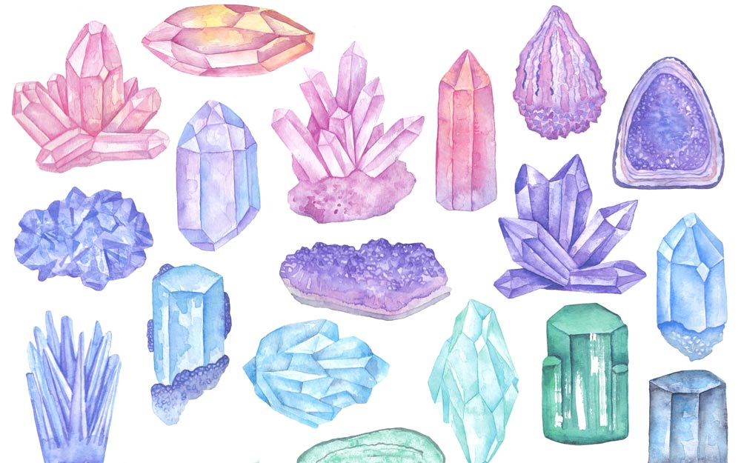
Hydrothermal crystal growth
What is hydrothermal crystal growth?
A brief history of hydrothermal growth
Pressure and temperature ranges, limitations, and equipment
An industrial example - Quartz
Hydrothermal synthesis at MFF

Slide 2
What is hydrothermal crystal growth?
Flux growth
is a method of crystal growth where the components of the desired substance are dissolved in a solvent (flux). The method is particularly suitable for crystals needing to be free from thermal strain. It takes place in a crucible made of highly stable, non-reactive material.
Problem:
Sometimes solubility is low at temperatures up to the (ambient pressure) boiling point.
Solvothermal process
A solvothermal process can be defined as a process in a closed reaction vessel inducing a decomposition or a chemical reaction(s) between precursor(s) in the presence of a solvent at a temperature higher than the boiling temperature of this solvent.
G. Demazeau, Zeitschrift Für Naturforsch. 65, 999 (2010).
Hydrothermal growth
Is a subgroup of the solvothermal method, where water is the specific solvent.

Slide 3
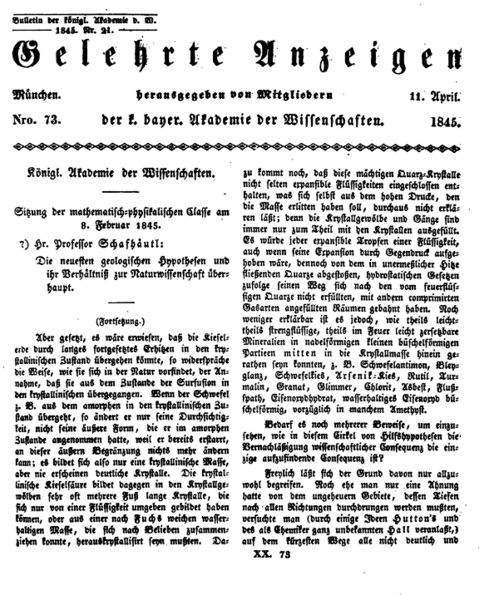
A brief history of hydrothermal growth
Karl Emil von Schafhäutl
Royal Bavarian Academy of Sciences, 20 (1845) 557.
Bildeten sich aus Wasser, in welchen ich im Papinianischen Topfe frisch gefällte Kieselsäure aufgelöst hatte, beym Verdampfen schon nach 8 Tagen Krystalle, die zwar mikroscopisch, aber sehr wohl erkenntlich aus sechseitigen Prismen mit derselben gewöhnlichen Pyramide bestanden."
There formed from water in which I had dissolved freshly precipitated silicic acid in a Papin pot [pressure cooker], after just 8 days of evaporating, crystals, which albeit were microscopic but consisted of very easily recognizable six-sided prisms with their usual pyramids.

Slide 4
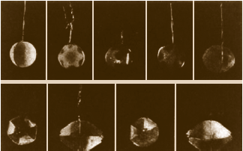
A brief history of hydrothermal growth
Early years (~1840s – 1900s)
Attempts by earth-scientists to copy and study mineral formation in the earth
1946 Nacken
Big quartz crystals
1857 Saubt-Claire Deville
First use of a mineraliser
1840s
1900
Modern hydrothermal techniques
1873 Von Chrustschoff
Use of lined reaction vessels
1851 H DeSenarmount
Sulfates and Sulfides
1970s It all got a bit boring
1848 Bunsen
Thick walled glass reactions
1891 Friedel
High temp. synthesis of corrundum
1979 The Chemistry + Geochemistry of solutions at high temperatures and pressures
1982 First international hydrothermal symposium

Slide 5
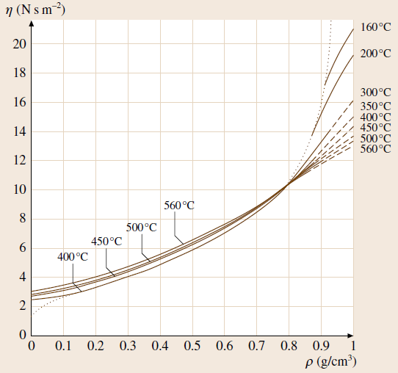
Pressure and temperature ranges, limitations, and equipment
Viscosity
As temperature is increased, the density decreases.
More importantly – as temperature increases and density decreases the viscosity decreases significantly.
This means better mixing within the reaction vessel.
The dissolving species move about more, so reactions or recrystallisation takes place much faster.
Separately as pressure increases, the dielectric constant of water increases. This means the H₂O molecules become less polar, decreasing the solubility of ionic compounds.

Slide 6
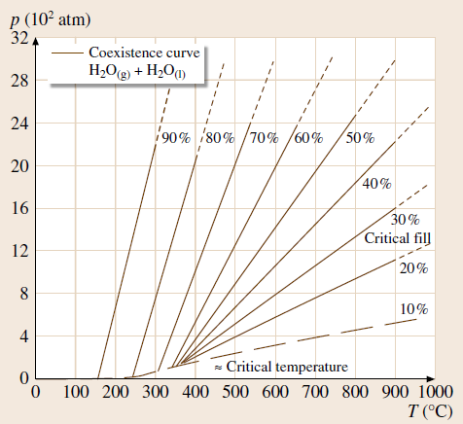
Pressure and temperature ranges, limitations, and equipment
Pressure
The internal pressure of a reaction vessel is closely linked to the initial liquid fill level.
Liquids are much less compressible than gasses.
The liquids expand as temperature increases.
If the liquid fills the vessel, pressure suddenly increases dramatically.
This is extremely important when considering the maximum pressures a vessel can handle
(The max my vessels can take is 1.22 x 10² atm.)

Slide 7
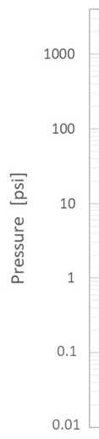
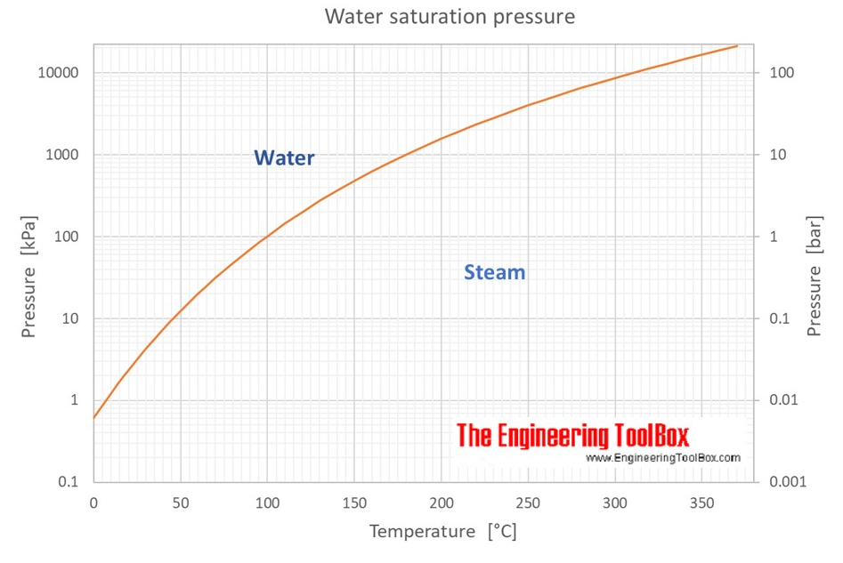
Pressure and temperature ranges, limitations, and equipment
Pressure
At lower temperatures and fill rates, the internal pressure is determined by the equilibrium between the liquid and the gas.
BUT – the fill rate must be low enough that liquid expansion does not fill the vessel!

Slide 8
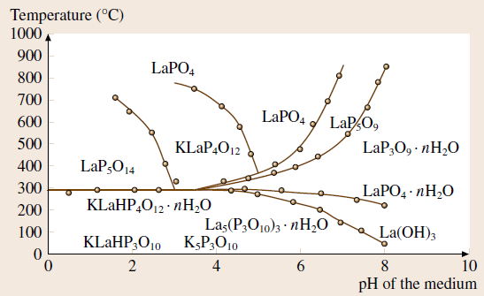

Pressure and temperature ranges, limitations, and equipment
Mineralisers
The solubility of the reactants can be tuned using mineralisers:
Typically sources of OH⁻, CL⁻, F⁻, Br⁻, I⁻ or H⁺
Acids: HCl, H₃PO₄, H₂SO₄, HCOOH
Neutral and alkali: NaOH, Na₃PO₄, NaHCO₃, NaF, KF, LiF, NH₄HF₂, NaCl, Na₂CO₃
e.g. In the presence of OH⁻, quartz become much more soluble due to the formation of these aqueous ions
Different phases that can be prepared in the
K₂O-La₂O₃-P₂O₅-H₂O system

Slide 9
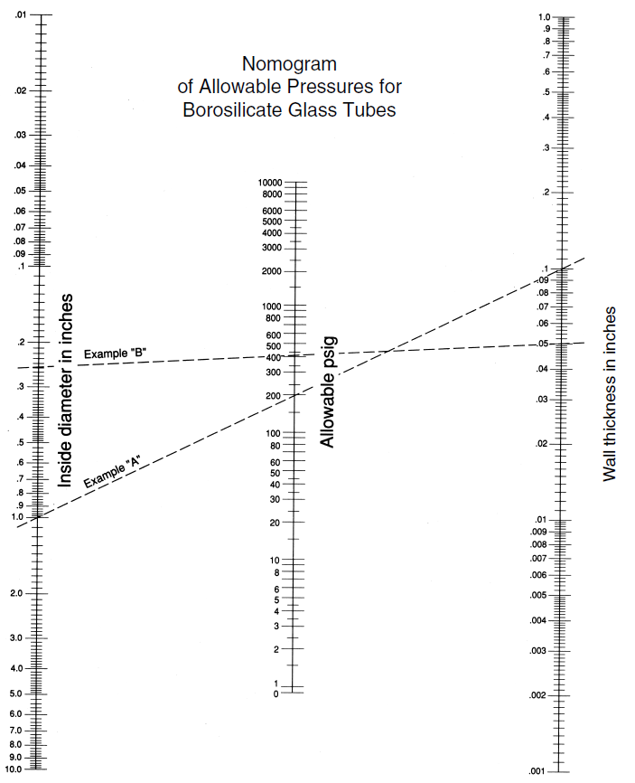
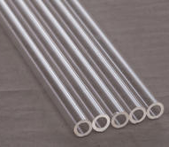
Pressure and temperature ranges, limitations, and equipment
Equipment
Glass tubes and quartz tubes
Pros:
Reaction is observable
Easy to clean prepare
Glass tubes are cheap
Cons:
Not very chemically resistant
Max temperatures ~300°C (glass)
[~1200 °C (quartz)]
Low maximum pressures (thickness dependent)

Slide 10
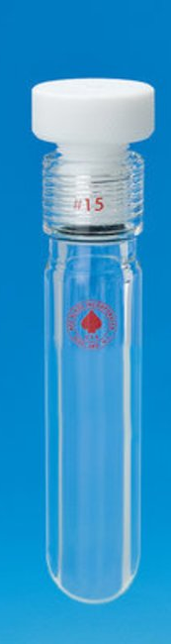
Pressure and temperature ranges, limitations, and equipment
Equipment
Ace-glass pressure tubes
Pros:
Reaction is observable
Easy to clean and reuse
Cons:
Not very chemically resistant
Max temperature 120°C
Max pressure 1800 psi

Slide 11
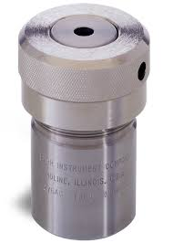
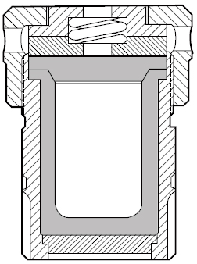
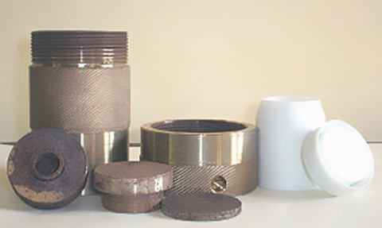
Pressure and temperature ranges, limitations, and equipment
Anti-bursting disk and corrosion resistance disk
Equipment
PTFE lined pressure vessels
Spring
Pros:
PTFE is resistant to most strong acids and many bases
Easy to clean and reuse
Cons:
Max temperature 250°C
Max pressure 1800 psi
Screw on lid
PTFE lid
PTFE liner
Steel main body

Slide 12
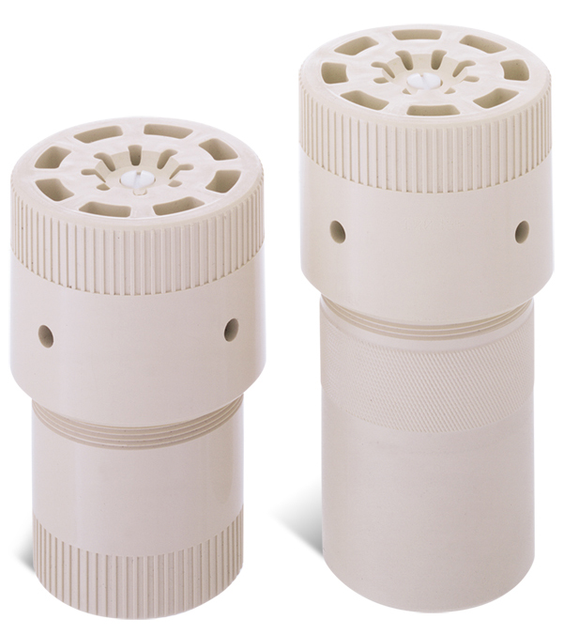
Pressure and temperature ranges, limitations, and equipment
Equipment
PTFE lined pressure vessels
Pros:
PTFE is resistant to most strong acids and many bases
Easy to clean and reuse
Cons:
Max temperature 250°C
Max pressure 1800 psi
Microwave vessels are now also available – typically for short reaction times.
(Rapid heating and short cycles means the outer casing remains cool and doesn’t have to be as heat resistant)

Slide 13
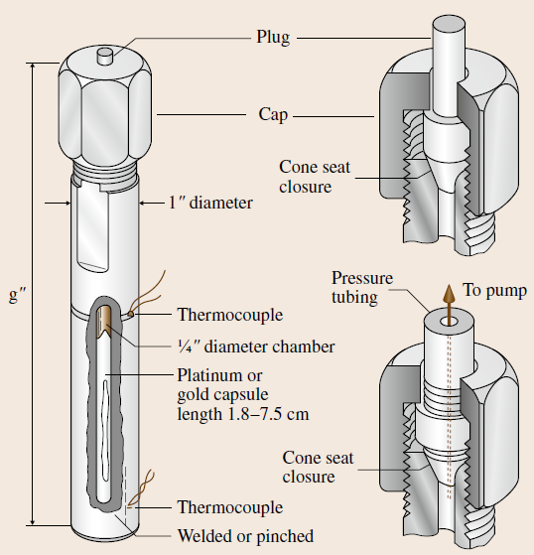
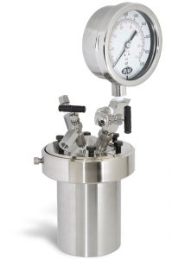
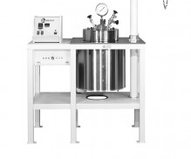
Pressure and temperature ranges, limitations, and equipment
Equipment
Pros:
Temperature ranges >600°C
Pressure ranges >8000 psi (>500 bar)
Temperatures and pressures highly controllable
Temperature gradients highly controllable
Cons:
Sealed linings must be used to prevent contamination from the vessel corrosion.
Expensive
Single batch
Higher pressures

Slide 14
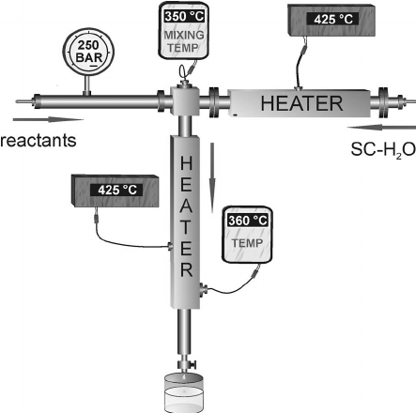
Pressure and temperature ranges, limitations, and equipment
Equipment
Typically for nano-particle synthesis
Continuous flow
Pros:
Can try many different reaction conditions in a single experiment
Cons:
Not for producing single crystals!

Slide 15
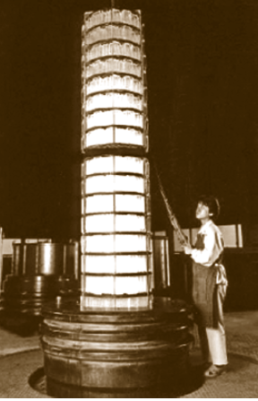
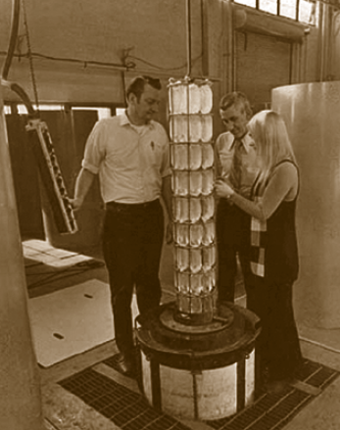
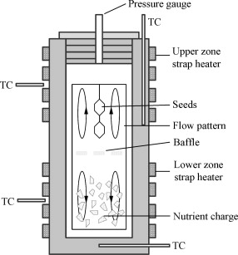
An industrial example - Quartz
Used due to their piezoelectric properties. They oscillate at a fixed frequency so can be used for timing devices (e.g. watches)
First large scale growth of quartz crystals was optimised at AT+T Bells labs (1970s)
Largest current reactor is in Japan
Hot zone: 425°C
Crystallising zone: 375°C
Pressure: 15000 – 25000 psi (1000-1700 atm.)
Growth rate: 1.0 – 1.25 mm/day
Amount produced per batch: 70 kg
Identical growth conditions
Amount produced per batch: 4000 kg
R.L. Barns, E.D. Kolb, R.A. Laudise, E.E. Simpson, and K.M. Kroupa, PRODUCTION AND PERFECTION OF Z-FACE QUARTZ (1976).

Slide 16
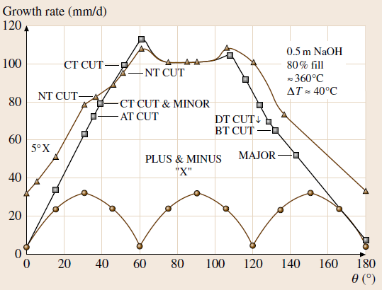
An industrial example - Quartz
Quartz
The growth speed is also effected by which face of the seed crystal is used.
Faster isn’t always better though – dislocations, inclusions or other defects are an important consideration and so different growth conditions are used depending on the application.

Slide 17
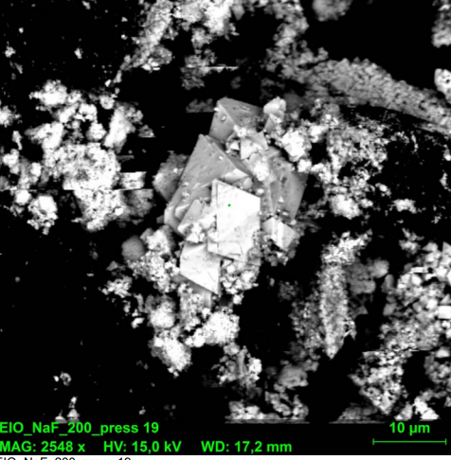
Hydrothermal synthesis at MFF
Iridate pyrochlores
RE₂Ir₂O₇ (RE = a rare earth ion)
These materials show very interesting magnetic and electronic properties as Ir has very large spin-orbit coupling.
BUT – Melting the oxides together doesn’t work: Iridium dioxide reacts at very low temperatures according to:
2IrO_{2(s)} + ½ O_{2(g)} ↔ Ir_{(s)} + IrO_{3(g)}
Flux synthesis (CsCl) can be used to produce a powder only.
Hydrothermal synthesis attempted with various concentrations of mineralisers:
H₂O + (0.2, 1, 4, 12 mol/dm³; KOH, NaOH, NaF, CsCl, KF)
Temperature 220 C, for several days → still no success!

Slide 18
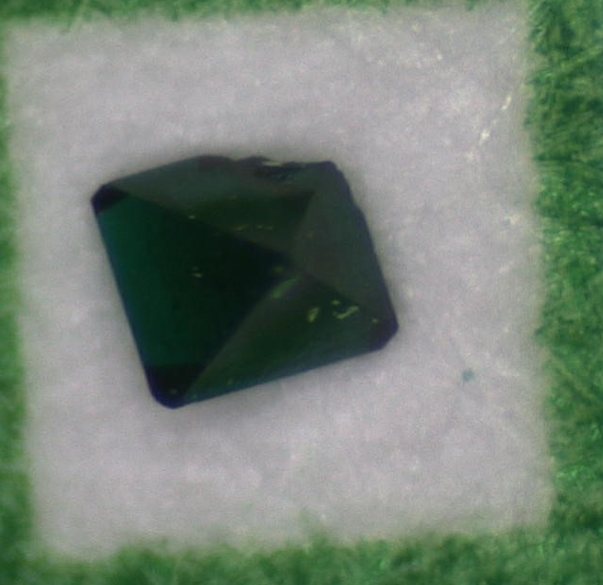
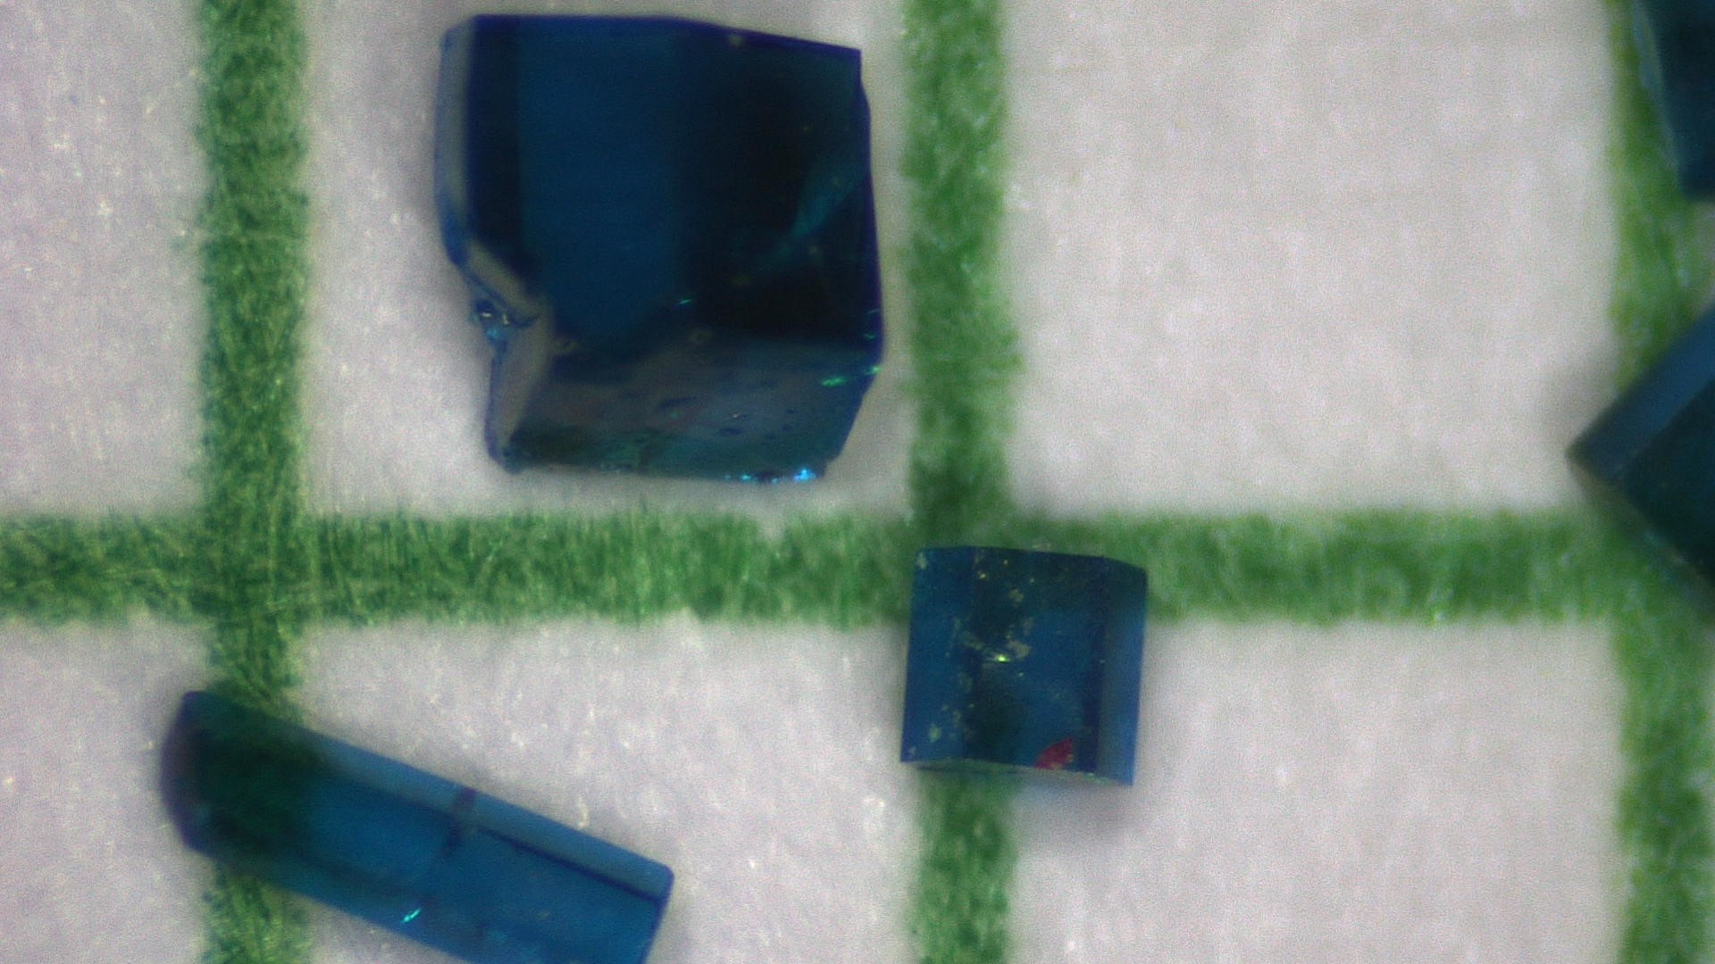
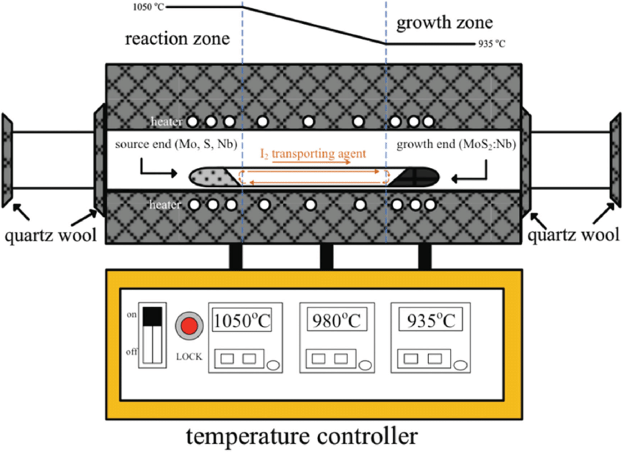
Hydrothermal synthesis at MFF
Kapellasite and Centennialite
α-Cu₃Zn(OH)₆Cl₃ , α-Cu₃Ca(OH)₆Cl₃
Kapellasite (α-Cu₃Zn(OH)₆Cl₃) is a quantum-spin-liquid material
– a type of magnet that does not order even down to 0 K.
So far it has only ever been studied as a powder
Centennialite (α-Cu₃Ca(OH)₆Cl₃) can be grown by hydrothermal temperature gradient
We are repeating the synthesis of Centennialite and attempting to use the method to grow kapellasite single crystals.
200
180

Slide 19
Hydrothermal synthesis at MFF
Kapellasite and haydeeite
Will my tube explode when I heat it up?
Tube thickness (OD) = 15 mm (0.506 inch)
Wall thickness (T) = 2 mm (0.0787 inch)
Quartz tensile strength (s) = 48.26 N/mm² (7000 psi)
We can use Barlow’s formula to estimate the bursting pressure of the tube:
Bursting pressure in psi = (2 x S x T) / (OD)
= (2 x 7000 x 0.0787) / (0.506)
= 2100 psi
Assuming we use a low filling rate, we can use the saturation temperature of water to determine the internal pressure:
At 220°C, the boiling pressure of water is 23 bar (333 psi)
Comfortably within the margin.

Slide 20
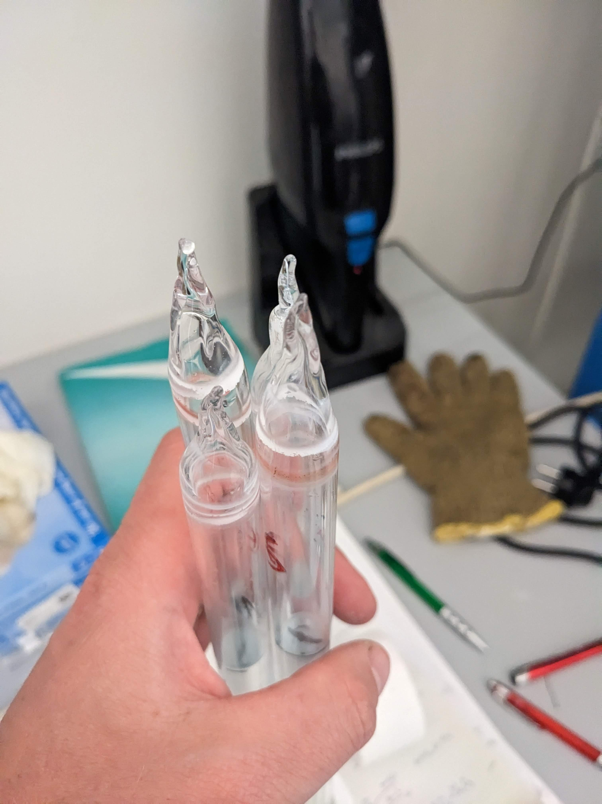
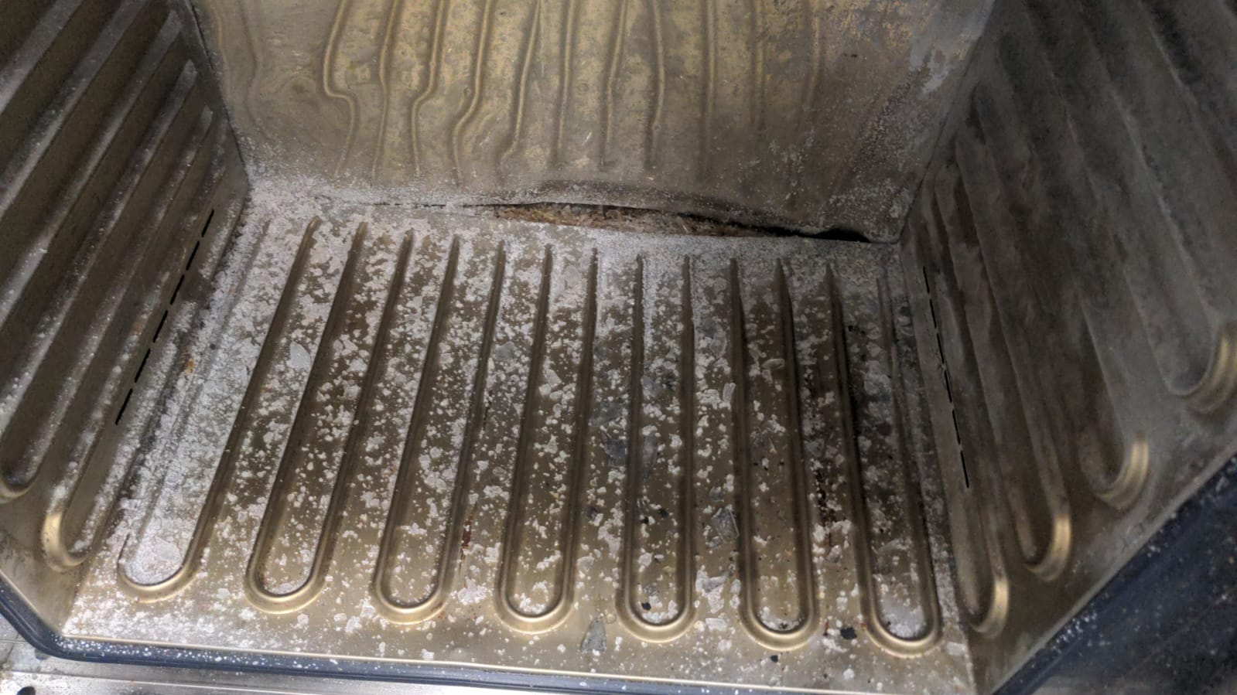
Hydrothermal synthesis at MFF
Kapellasite and centennialite

Slide 21
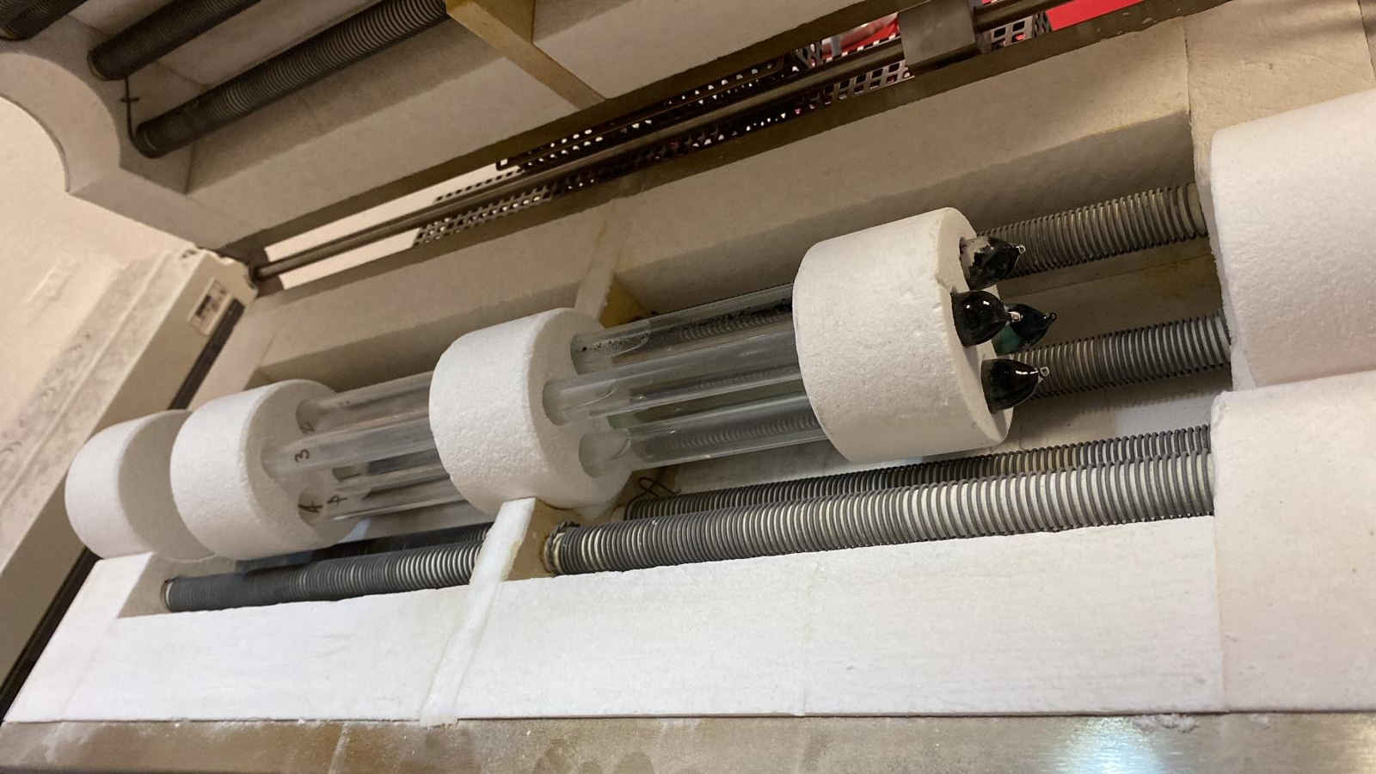
Hydrothermal synthesis at MFF
Kapellasite and centennialite

Slide 22
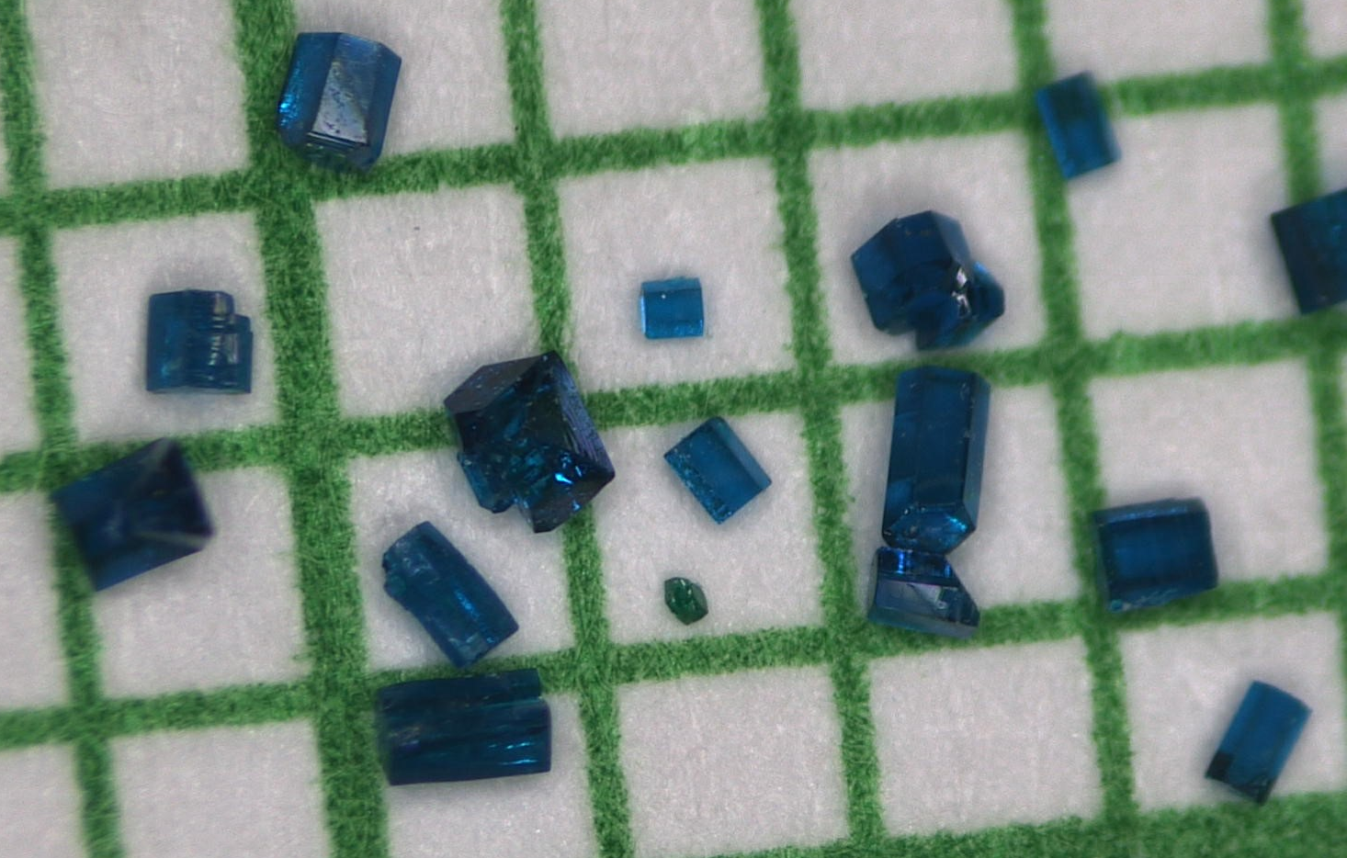
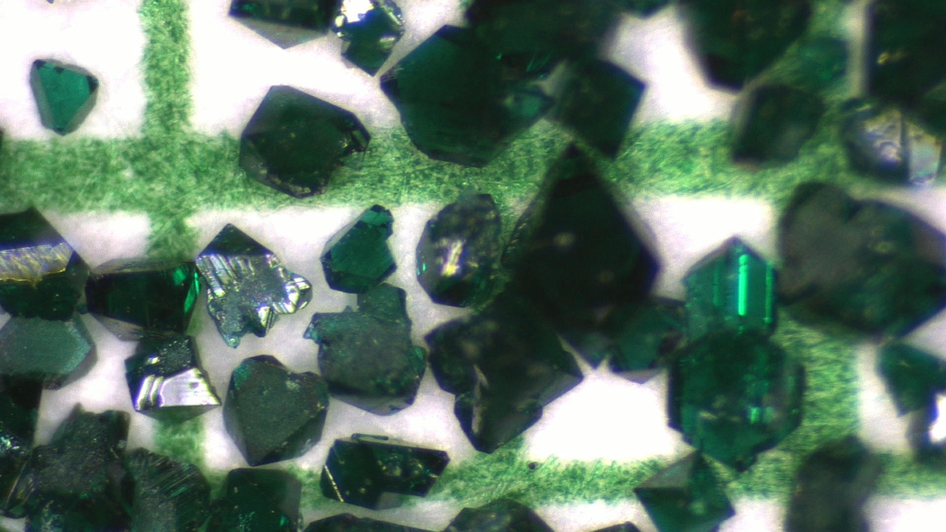
Hydrothermal synthesis at MFF
Kapellasite and centennialite
CuO + CaCl_{2(aq)} → Cu₃Ca(OH)₆Cl₂
[CaCl₂] 3 mol/dm³
[CaCl₂] 5 mol/dm³
Cu₃Ca(OH)₆Cl₂
Cu₄(OH)₆Cl₂

Slide 23
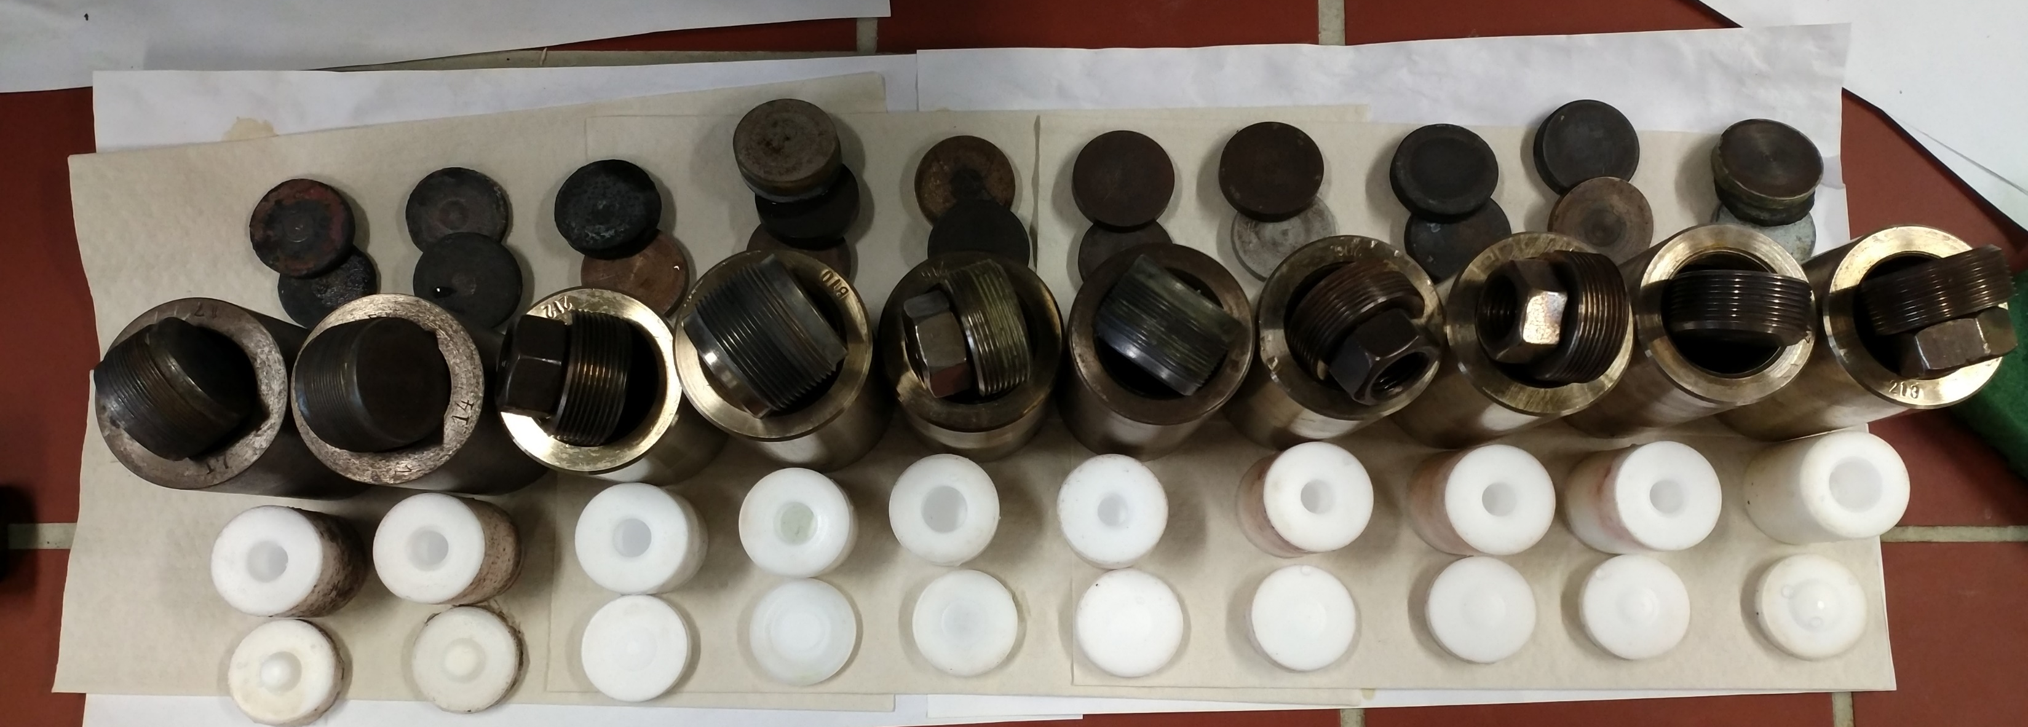
Hydrothermal synthesis at MFF
Engelhauptite
KCu₃V₂O₇(OH)₂Cl
Another candidate material for quantum-spin-liquid properties
A simple reaction: CuO + V₂O₅ + RbCl + H₂O
So far we have varied:
Reaction temperature: 180C – 220C
Reaction time from: 1 day – 1 month
Reaction ramp rate: 1 week cool down vs. quench into water
Acid (mineraliser) types and concentration: HCl, H₂SO₄, HNO₃
Ratios of the components: 20 different ratios ranging from 3:2:1 to 3:2:10 or 6:2:1

Slide 24
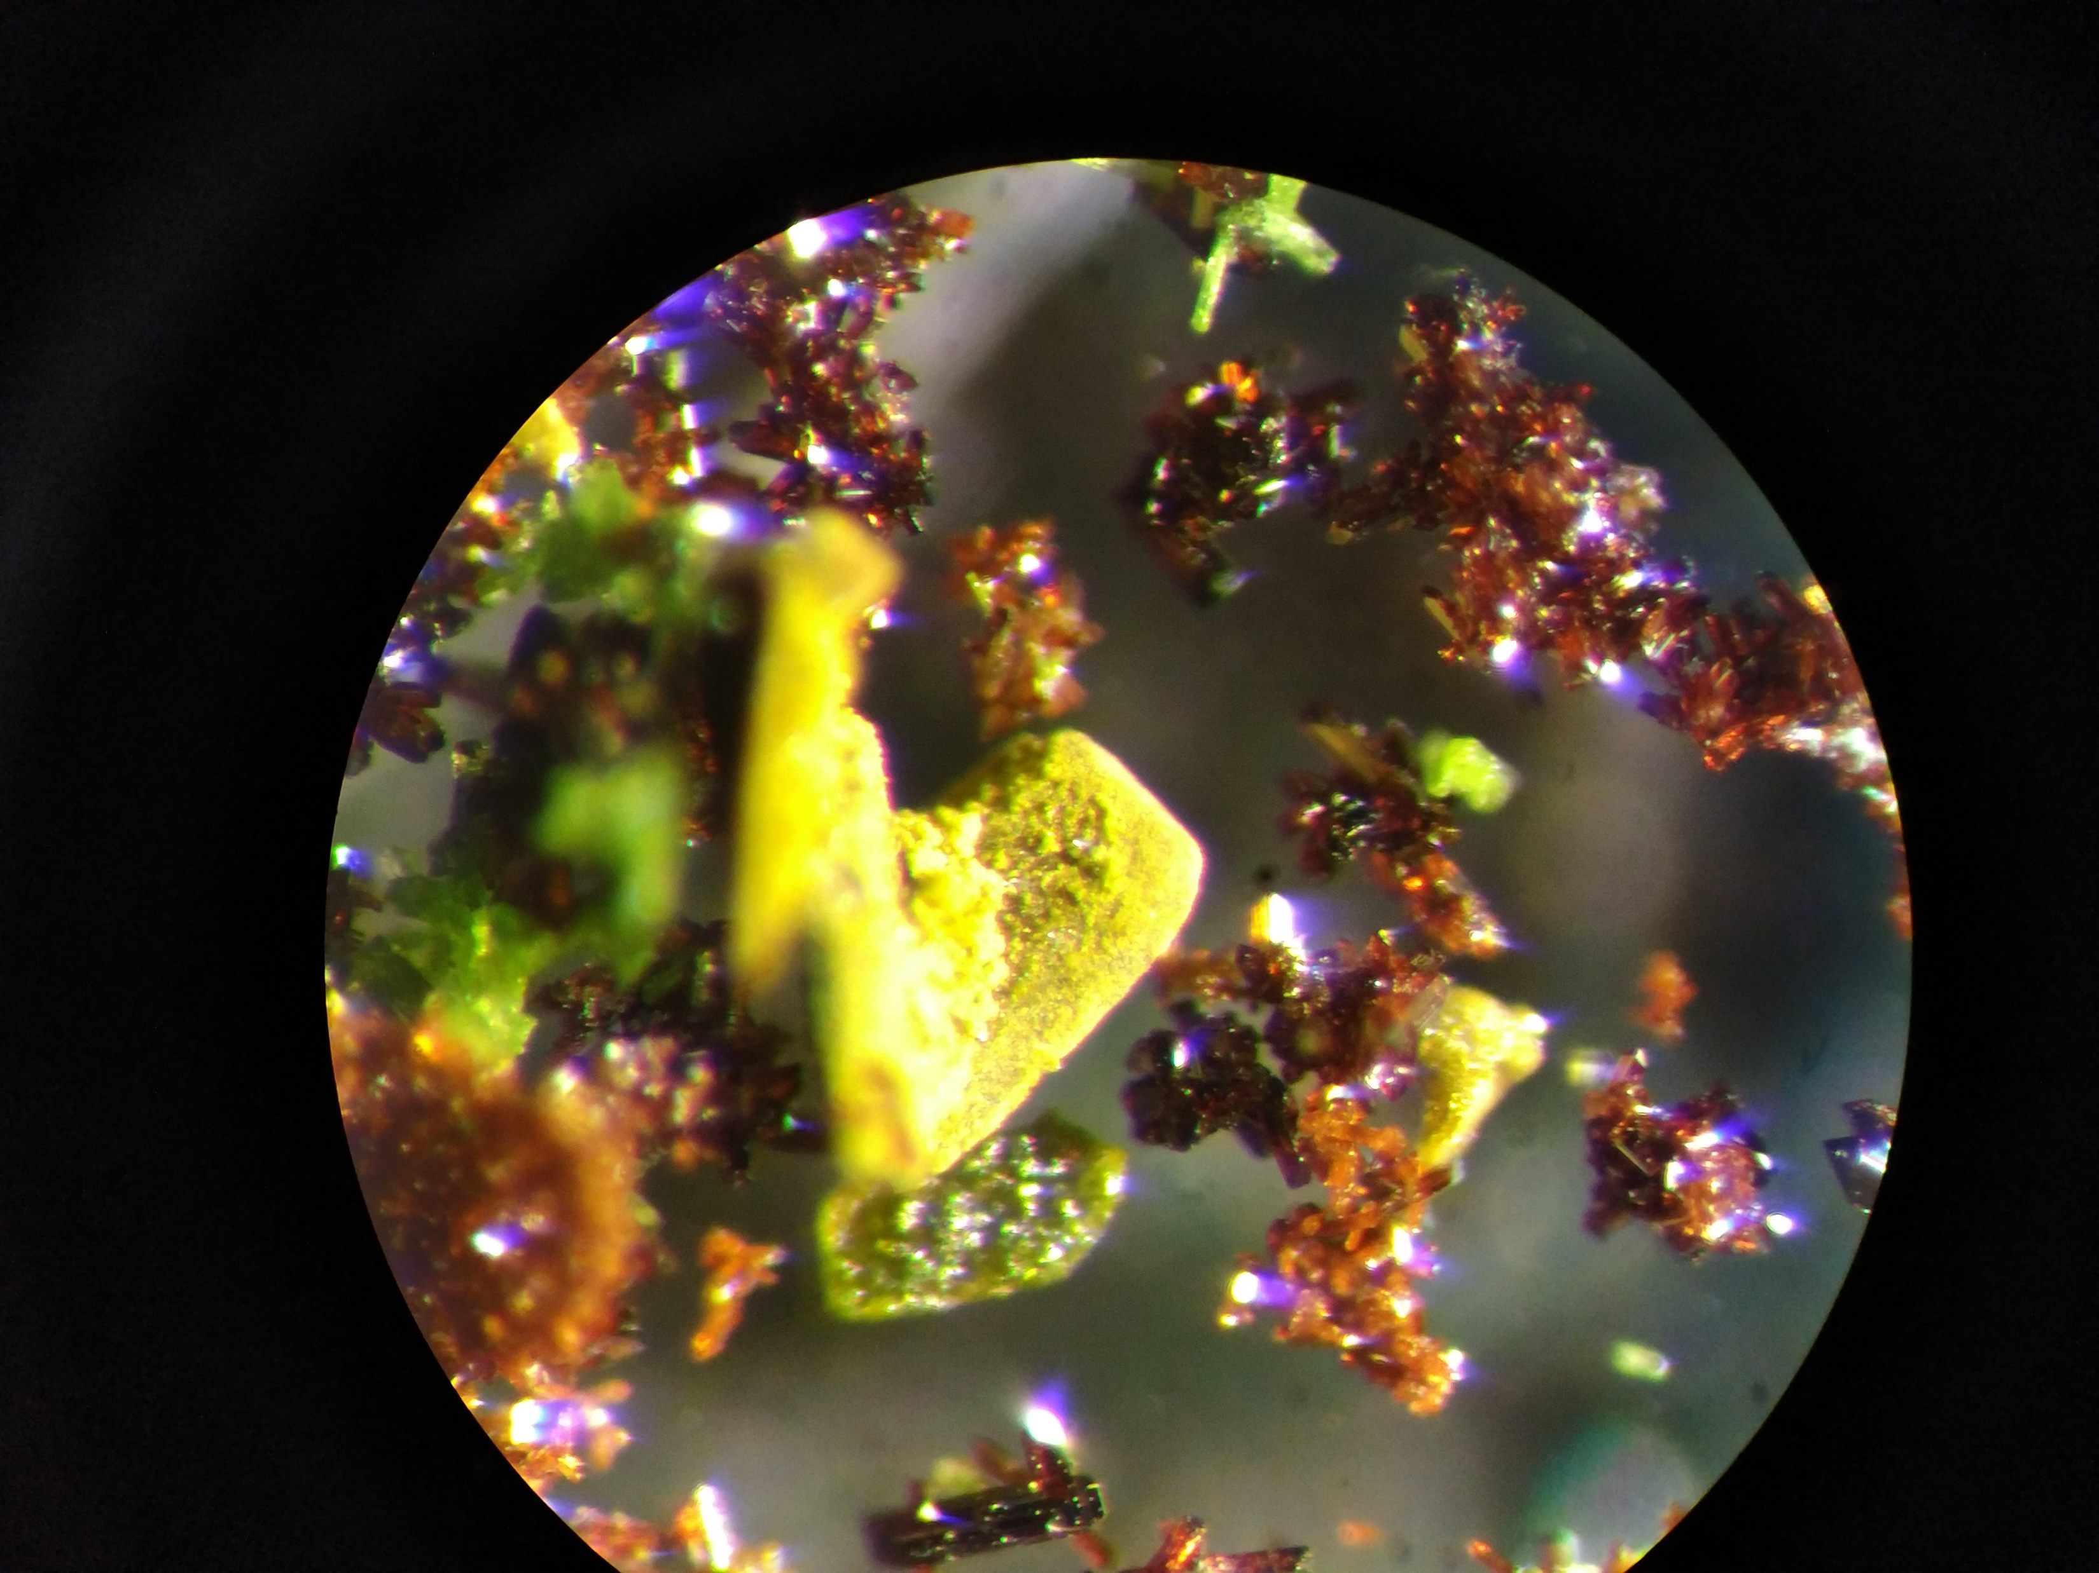
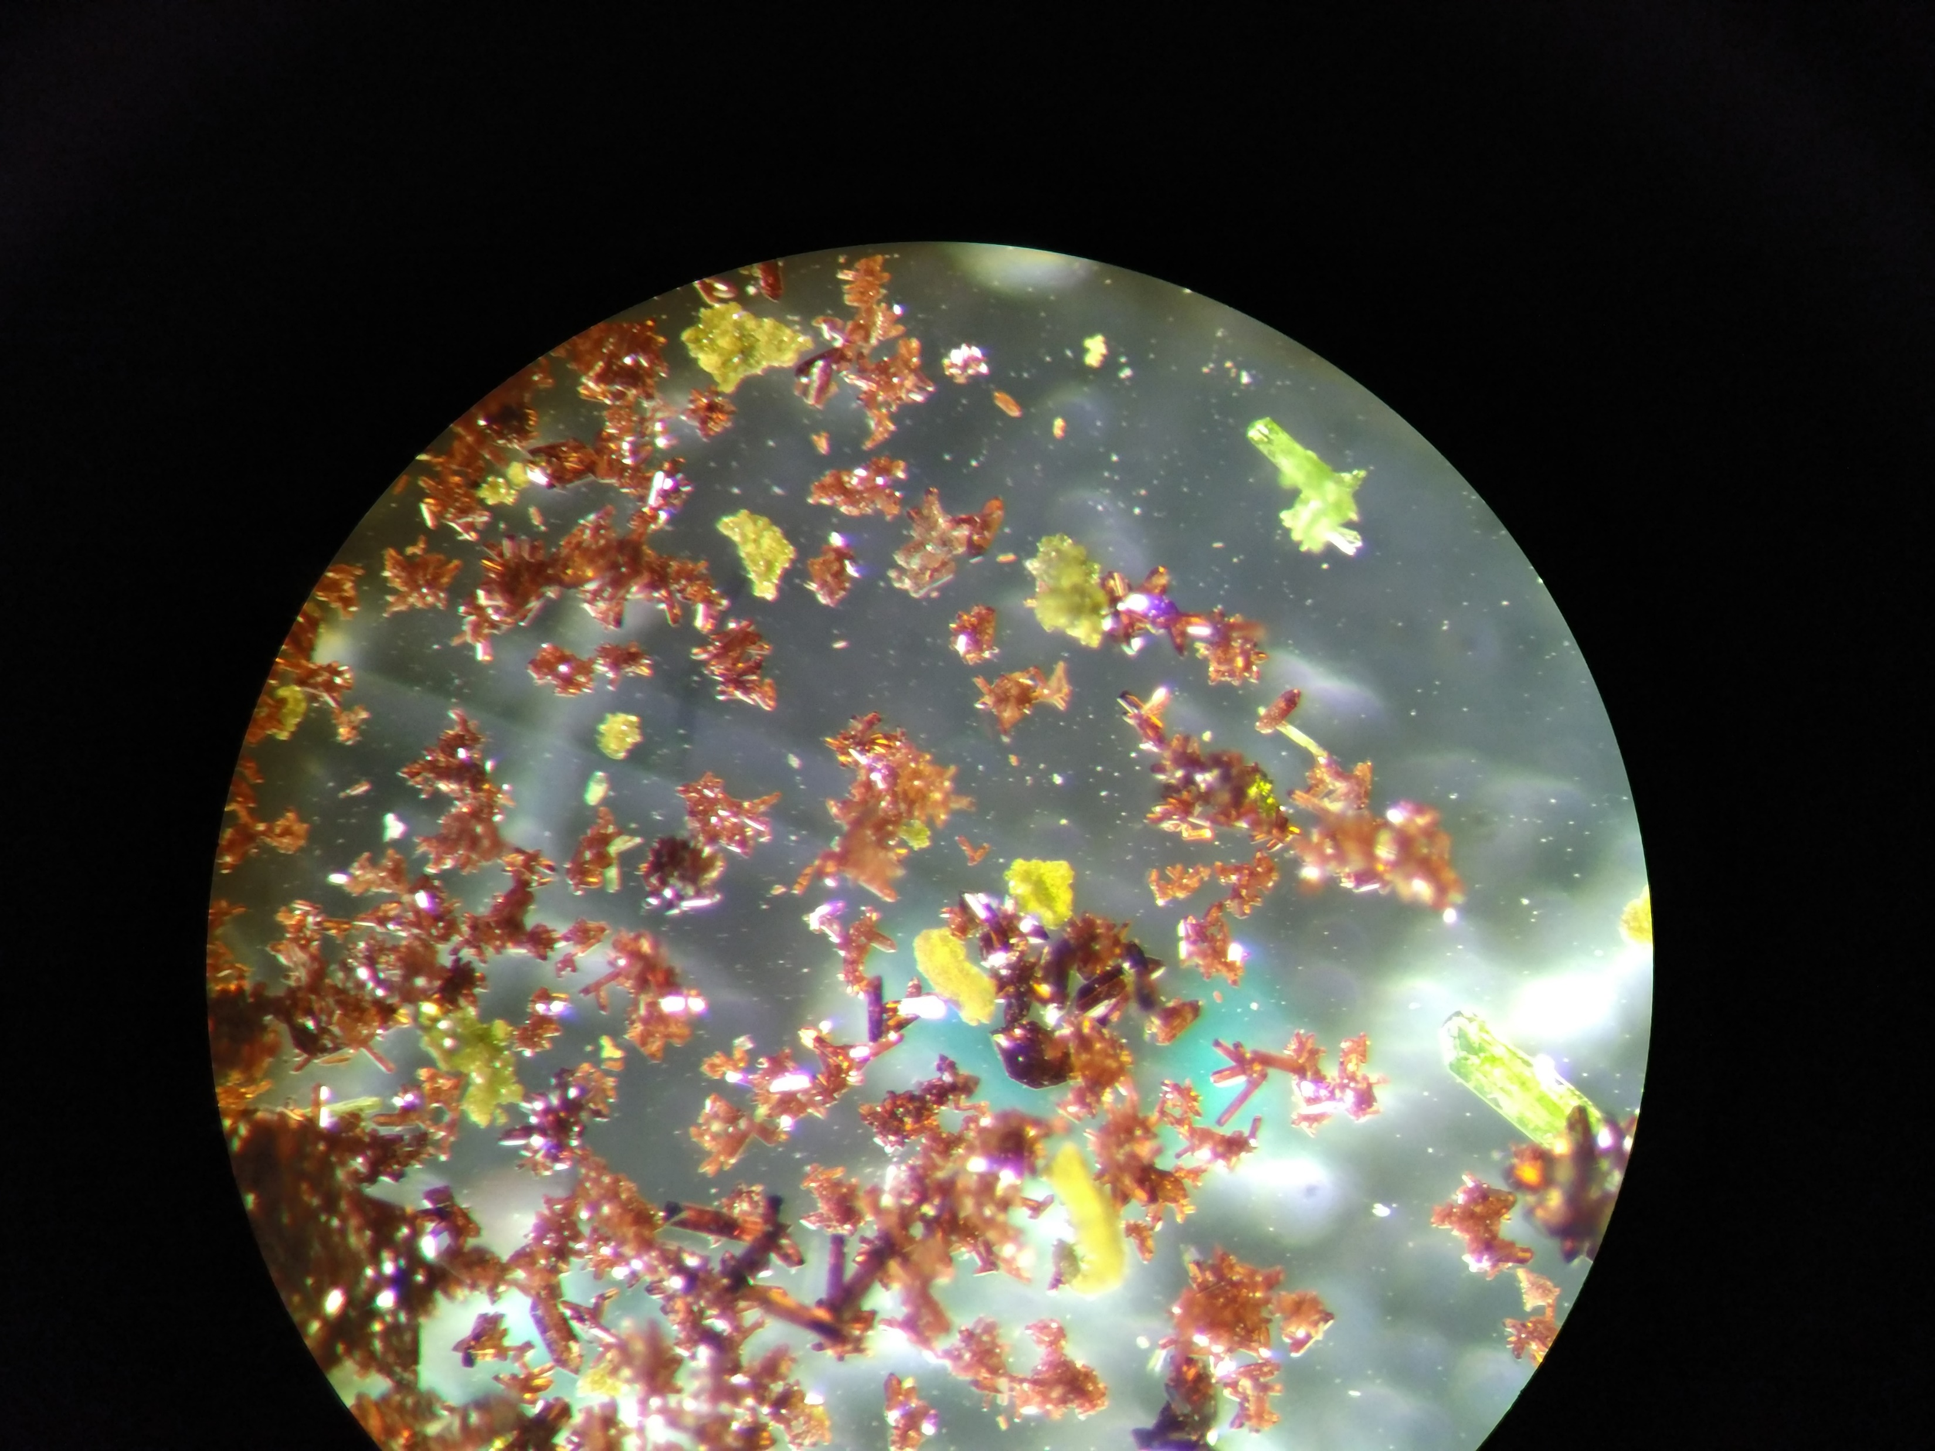
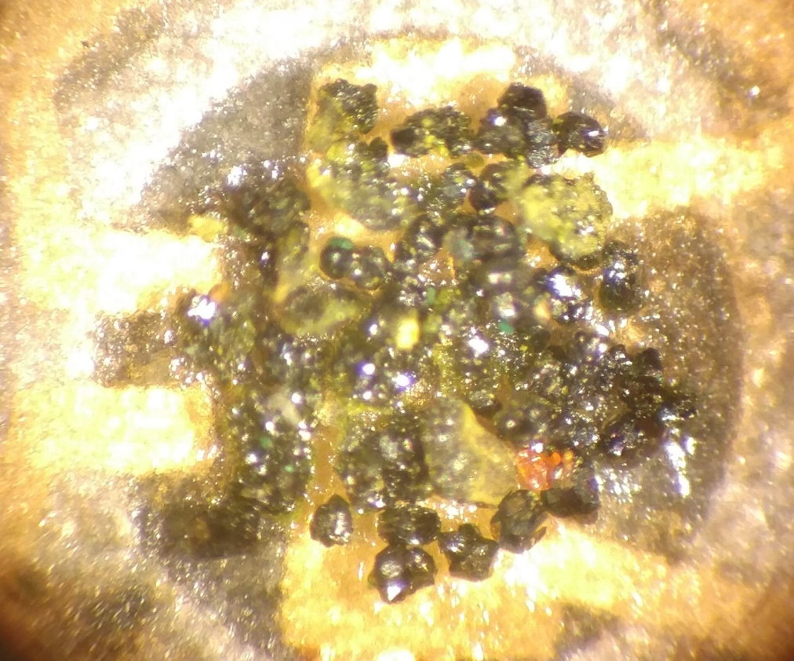
Hydrothermal synthesis at MFF
Engelhauptite
KCu₃V₂O₇(OH)₂Cl
Another candidate material for quantum-spin-liquid properties
So far we’ve identified a range of OTHER products:
KVO₈
Cu₄(OH)₆Cl₂
Cu₅(VO₄)₂(OH)₄
Cu₂(VO₄)(OH)
CuV₂O₆
Cu₃V₂O₇(OH)₂(H₂O)₂
CuCl₂(H₂O)₂
+ KCu₃V₂O₇(OH)₂Cl

Slide 25
Hydrothermal crystal growth
What is hydrothermal crystal growth?
A brief history of hydrothermal growth
Pressure and temperature ranges, limitations, and equipment
An industrial example - Quartz
Hydrothermal synthesis at MFF

Slide 26
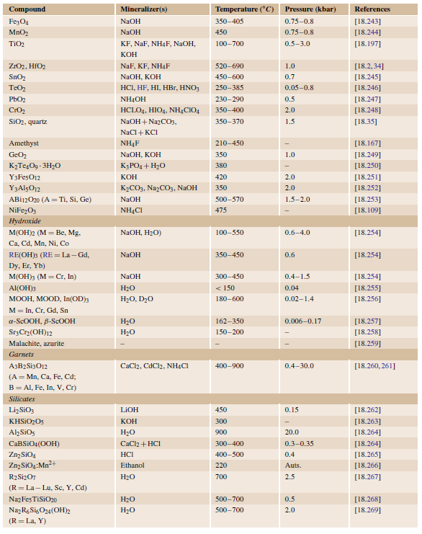
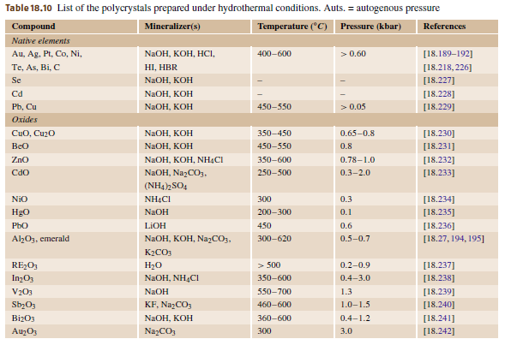

Slide 27
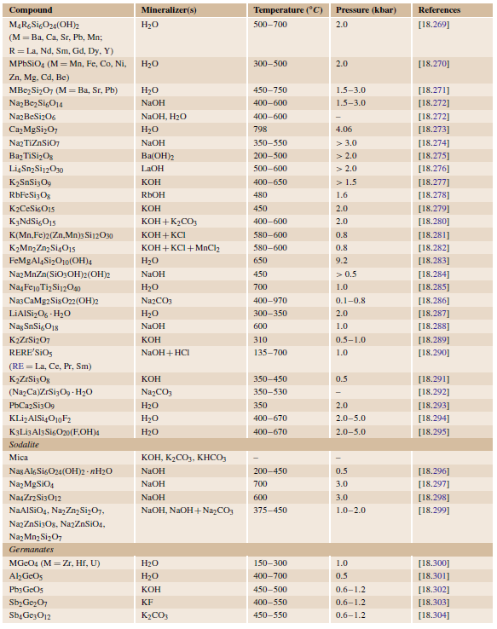
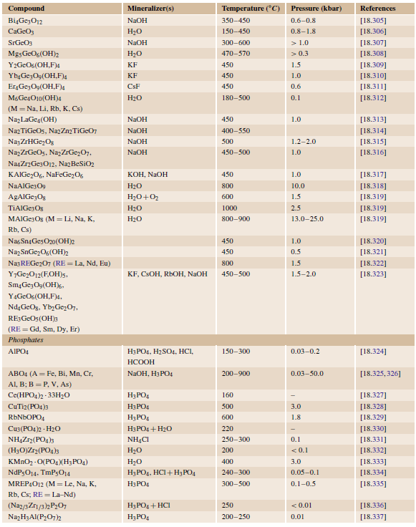

Slide 28
